Slide 1
ADV Measurements
4-9 Nov 2021
Mason Bichanich and Dr. Martin Wosnik
University of New Hampshire (UNH), Atlantic Marine Energy Center (AMEC)

Slide 2
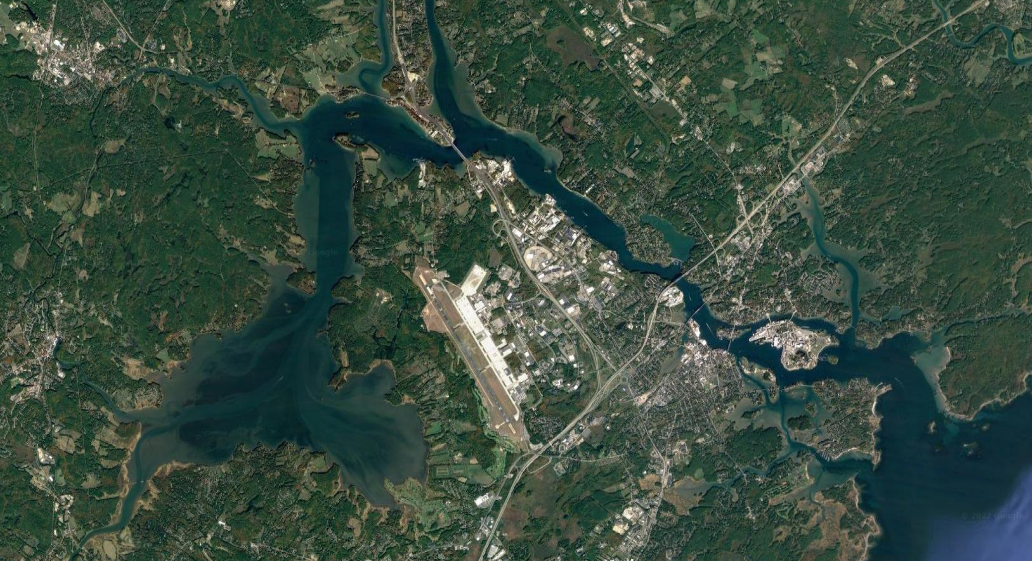
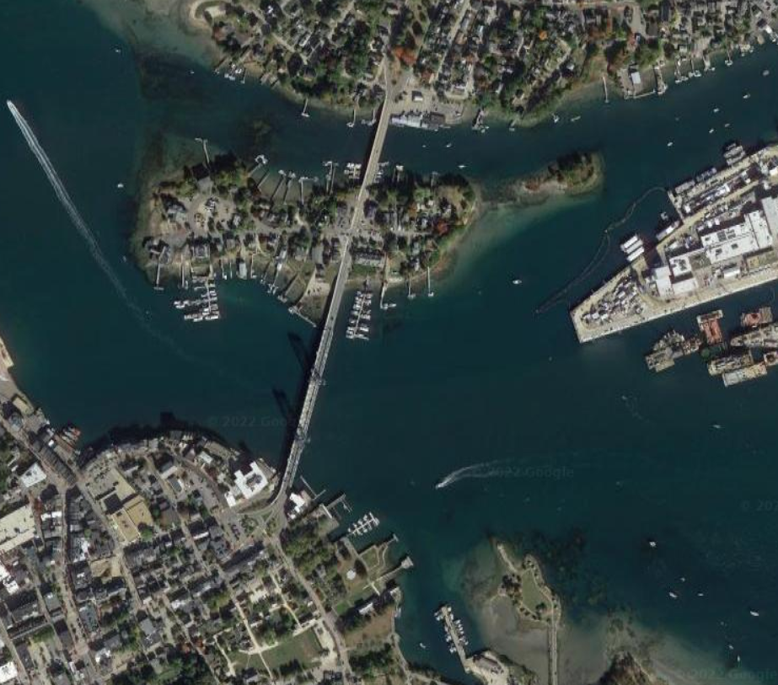
Test Site Location
Right: Map of the Great Bay/Piscataqua River Estuary. Imagery ©2022 CNES/Airbus, Landsat/Copernicus, Maine GeoLibrary, Maxar Technologies, US Geological Survey, USDA/FPAC/GEO, Map data ©2022 Google.
University of New Hampshire
Piscataqua River
Kittery, ME
Kittery, ME
Portsmouth, NH
Memorial Bridge
Great Bay
Gulf of Maine
Great Bay
Left: Map of the deployment site. Imagery ©2022 Maine GeoLibrary, Maxar Technologies, US Geological Survey, USDA/FPAC/GEO, Map data ©2022 Google
Memorial Bridge
Gulf of Maine
Deployment Site
Portsmouth, NH

Slide 3
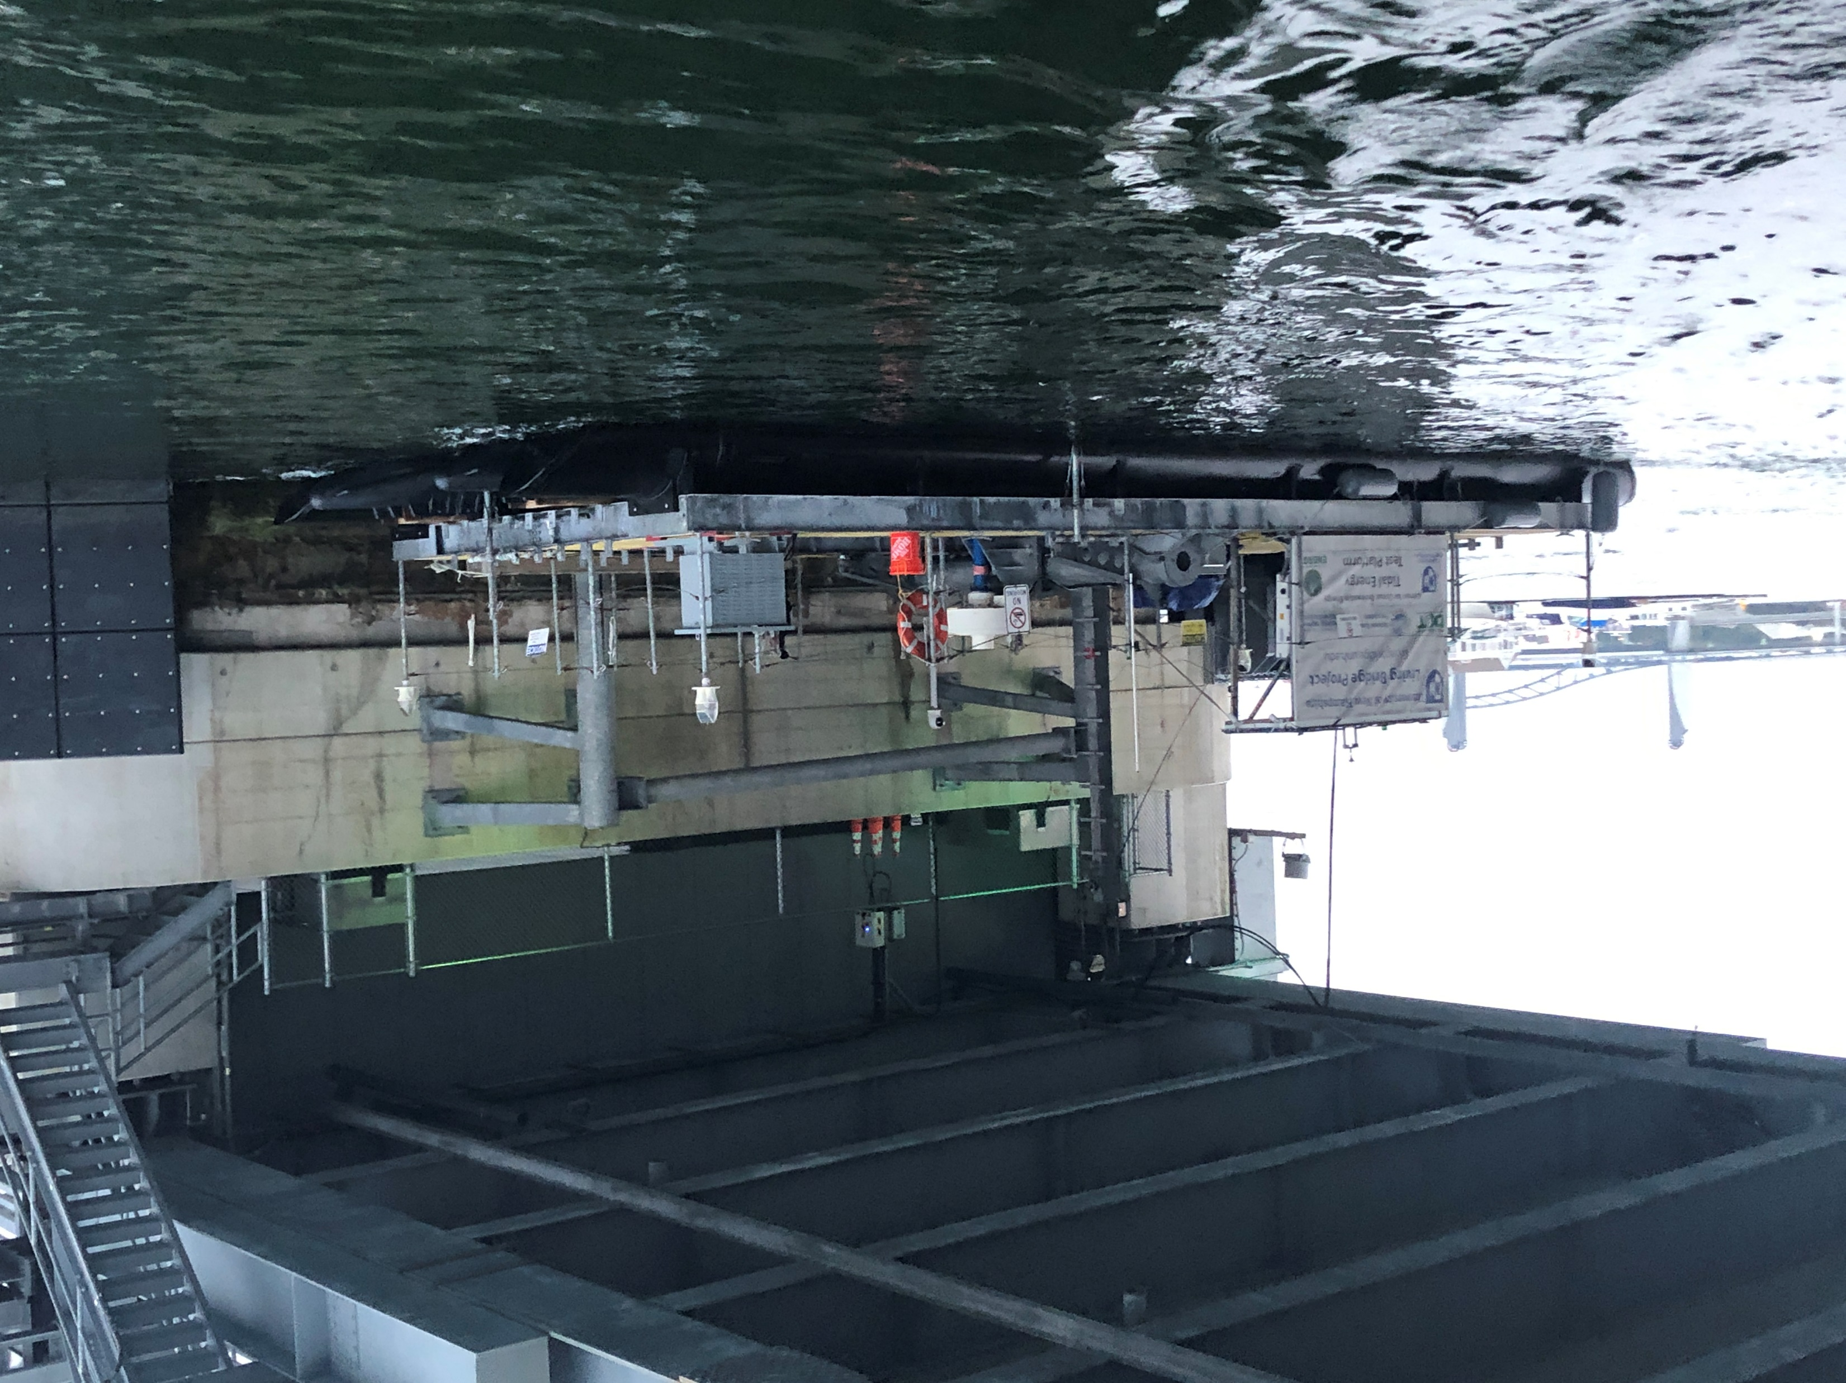
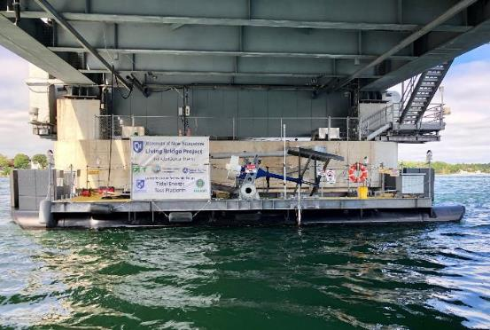
UNH-AMEC turbine deployment platform (TDP)
The TDP is a 15 m x 6 m, floating pontoon structure moored to the Memorial Bridge between Portsmouth, NH and Kittery, ME over the Piscataqua River
Water depth at the TDP is nominally 18 meters, with ~3 meters of tidal range
The two ADVs in this submission were mounted on the bow (facing away from the viewer in the photo) and the stern (facing towards the viewer)
The bow ADV data represents the inflow velocity to the turbine on the ebb tide, and the stern ADV represents the inflow on the flood tide

Slide 4
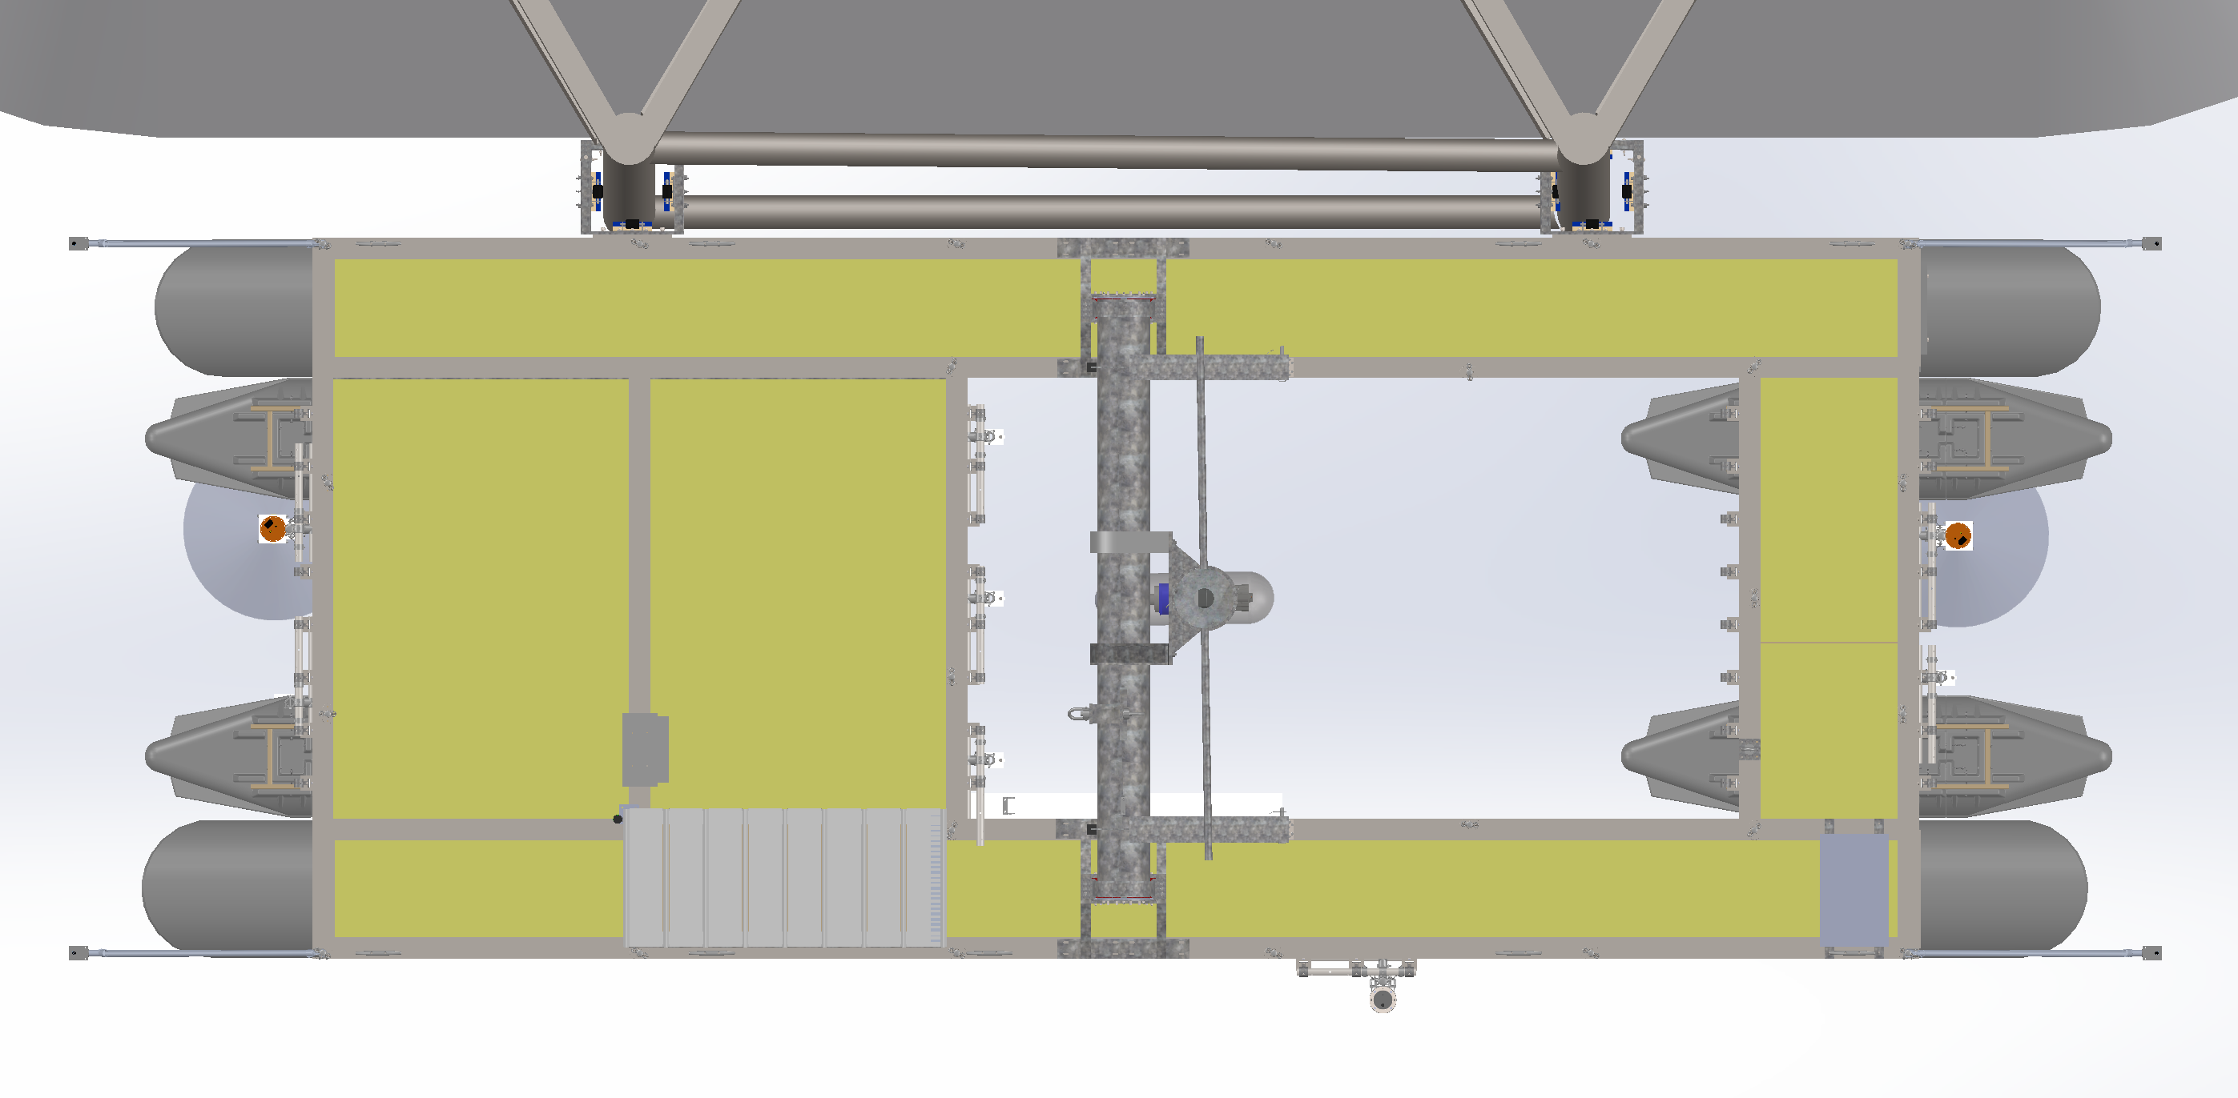
ADV Deployment Locations
Bow
Stern
Spanning Beam
Y
x
Flood
Ebb
0.7 m
X
Z
2
12.8 m
1
ADV Deployment Depth = 2 meters
6.4 meters up and downstream of spanning beam (x-direction)
0.7 meters horizontal offset from TDP centerline (y-direction)
= ADV deployment location

